Slide 1

HANDLING LEXICAL AMBIGUITY IN PROMPTS
A Step Towards Clearer Communication with NLP
AYUSHI PRASAD : MT2023145
DRISHTI GUPTA : MT2023099

Slide 2


The challenge of lexical ambiguity in prompts
Lexical ambiguity, where words or phrases have multiple meanings, poses a significant challenge for Natural Language Processing (NLP) models.
1. Misinterpretations
2. Unintended Outputs
3. Inaccurate Results
4. Wasted Resources
5. Communication Breakdown

Slide 3

Sharper Instructions, Clearer Results: Benefits of Disambiguating Prompts
Clearer prompts lead to more accurate outputs from NLP models.
Disambiguated prompts reduce the need for rework and debugging
By tackling ambiguity, you unlock the full potential of your NLP models to deliver accurate and reliable results
Users are more likely to trust and rely on NLP tools when they receive consistent and accurate outputs

Slide 4
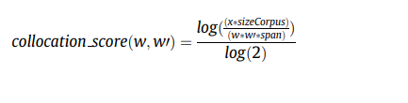
Technique used for disambiguation
WSD method to find the correct sense of a word present in a sentence :
The method uses both the WordNet lexical dictionary and the Wikipedia corpus. Initially, we find all the probable senses of the target word using WordNet. For each of the words present in a sense, we calculate the collocation extraction score with the other words in the sentence. The collocation extraction score finds the probability of the occurrence of two words together in the Wikipedia corpus. The maximum collocation extraction score assigns the proper sense for that context of the sentence.

Slide 5
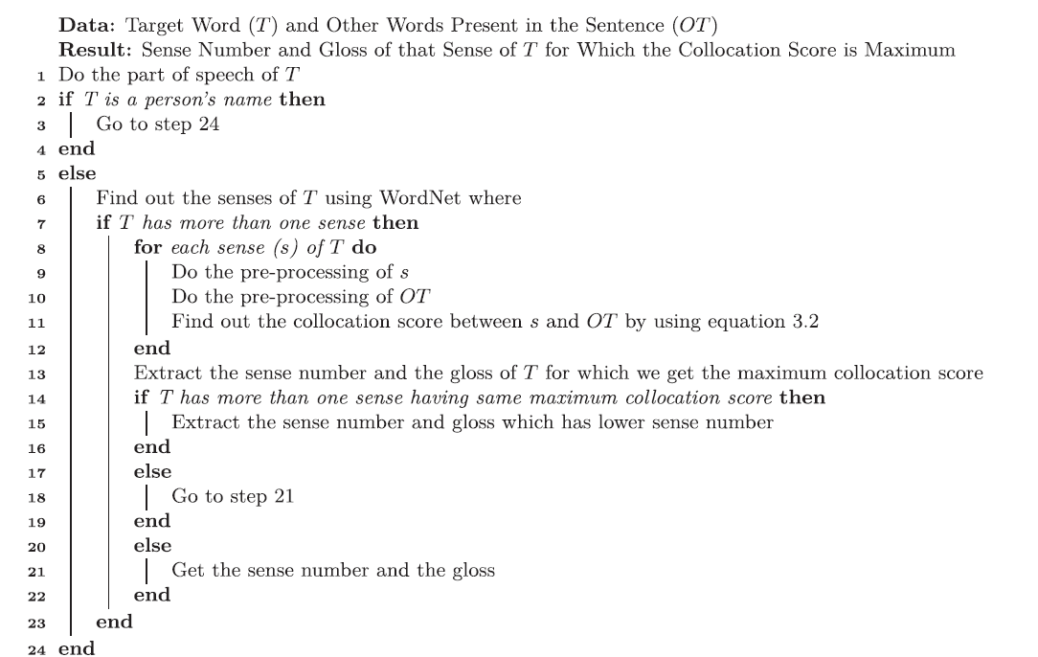
Algorithm

Slide 6
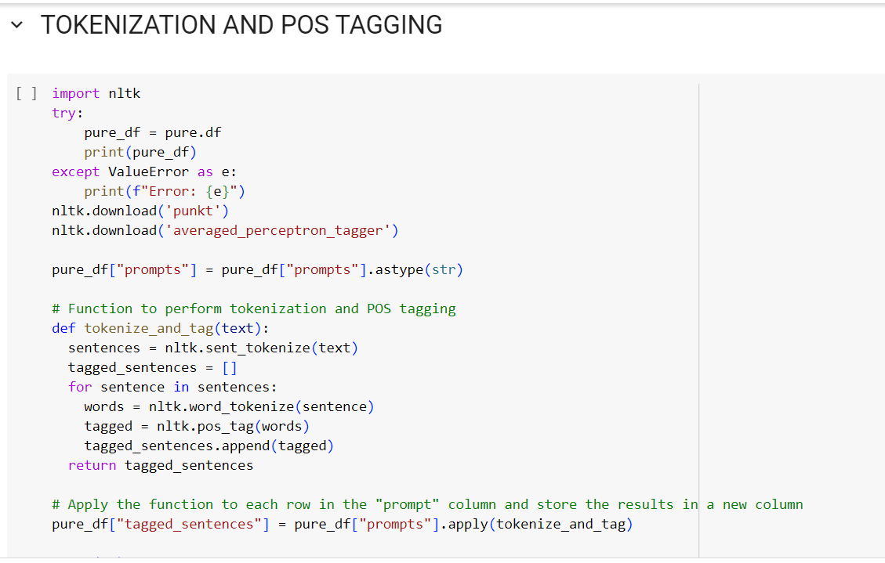
1. Lexical and syntactic processing

Slide 7
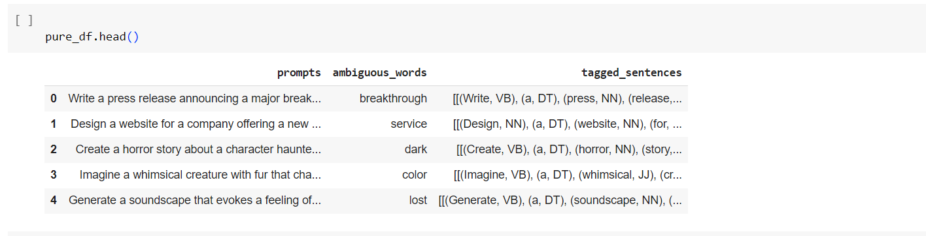

Slide 8
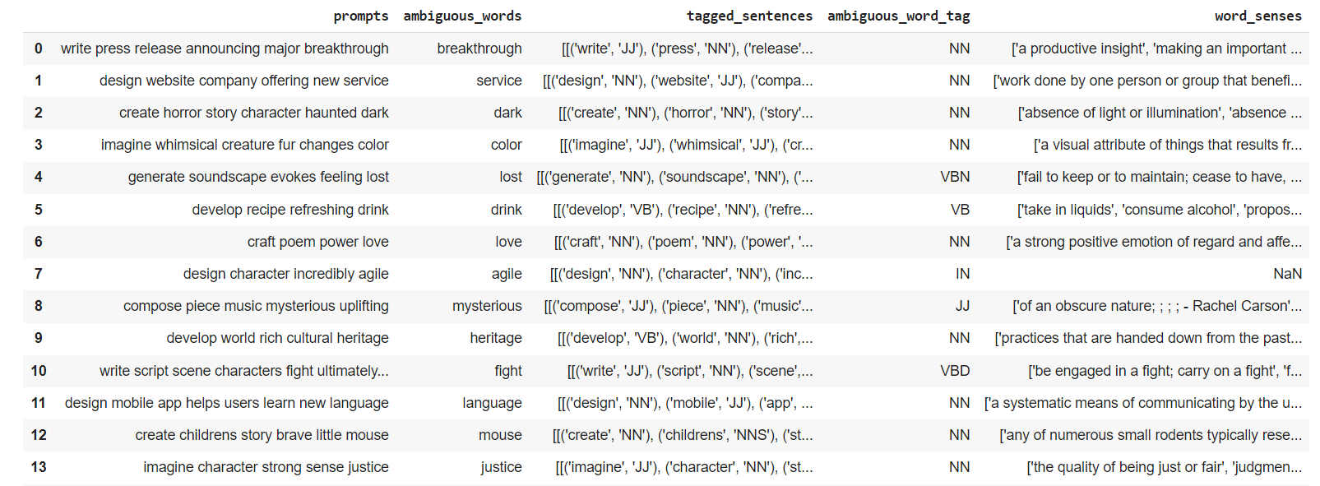
2. Finding senses of ambiguous words from WORDNET

Slide 9
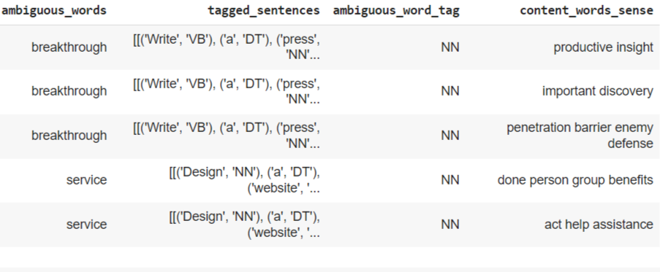
3. Getting content words of senses

Slide 10
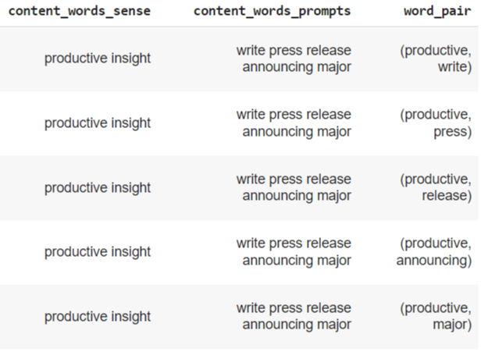
4. Making pairs

Slide 11
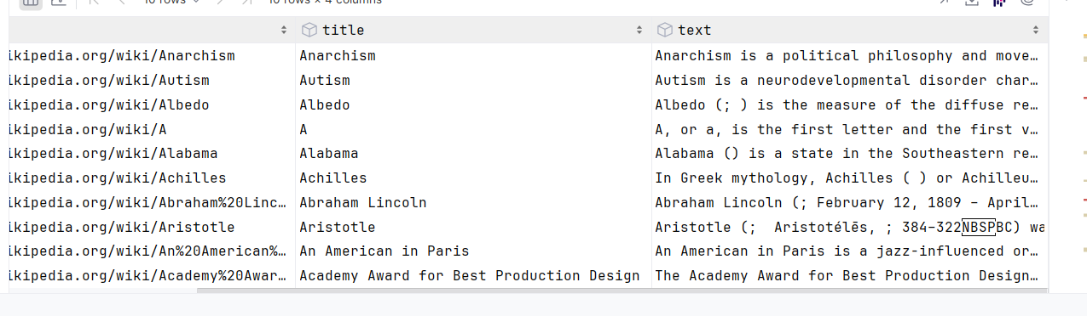
5. Wikipedia corpus
A Wikipedia corpus is a massive collection of text data extracted from Wikipedia articles. Imagine all of Wikipedia's text content, like articles, definitions, and references, compiled into a single dataset. This treasure trove of information is valuable for tasks like training language models, analyzing writing styles, and exploring factual topics.

Slide 12
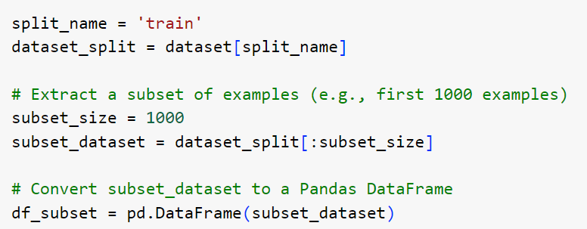
Challenge faced ….
We took subset of wikipedia dataset after downloading the entire corpus dataset as it was taking a lot of time to find the frequency of words in the entire corpus and it failed at the end. So we created a subset of 1000 examples from wikipedia corpus.

Slide 13
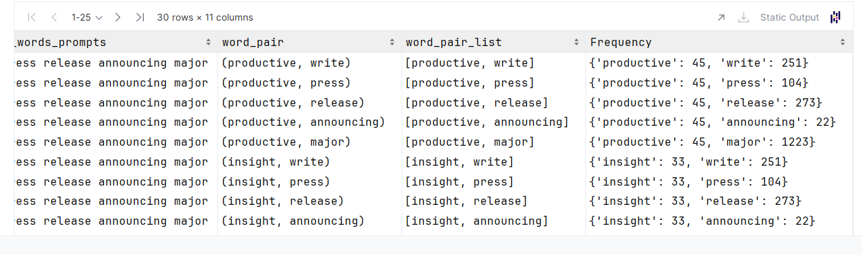
6. Finding frequency of individual words
Challenge faced ….
Initially we had 100 prompts in our dataset but as word_occurrences function was taking a lot of time to and it failed at the end so we decided to reduce our dataset to 50 prompts.Now we are working on 50 prompts only.

Slide 14
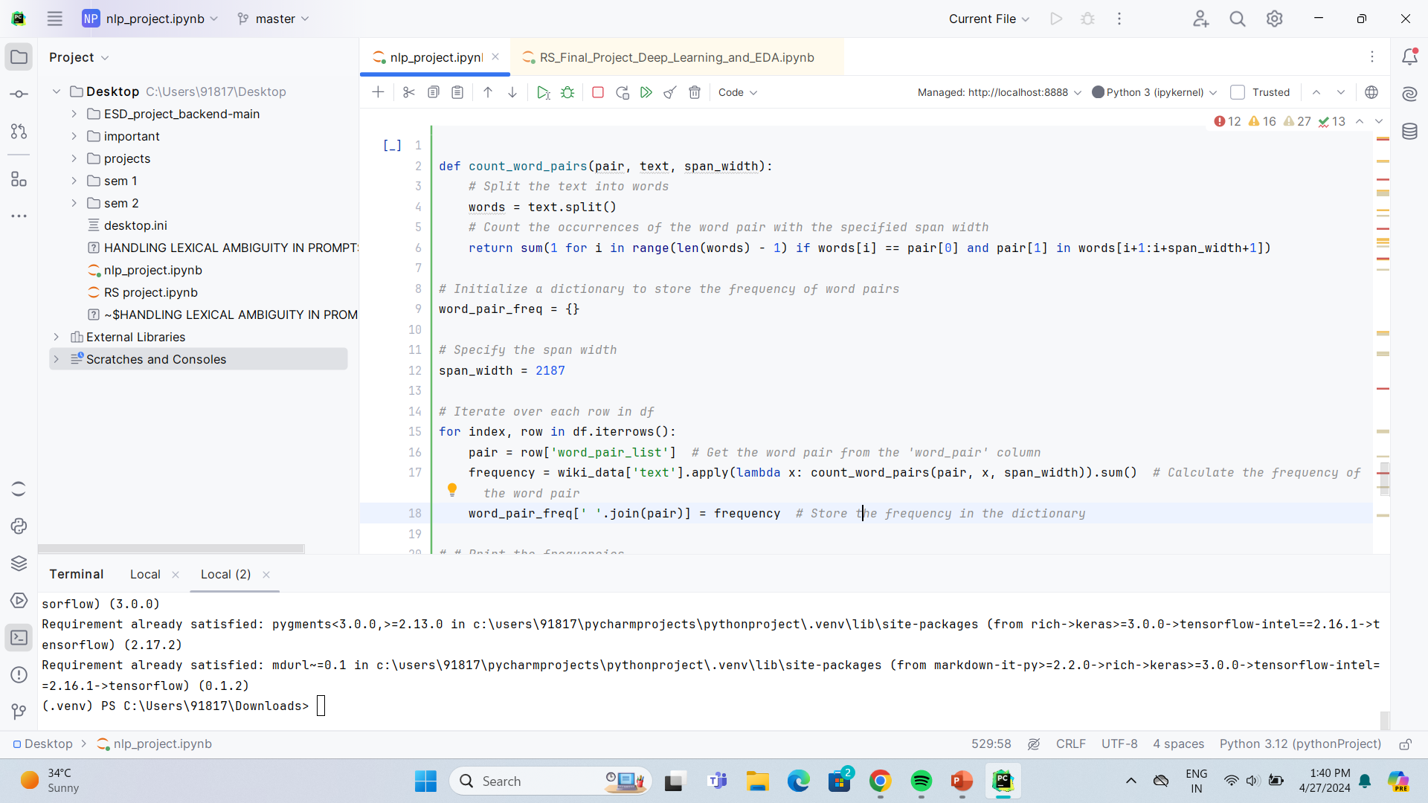
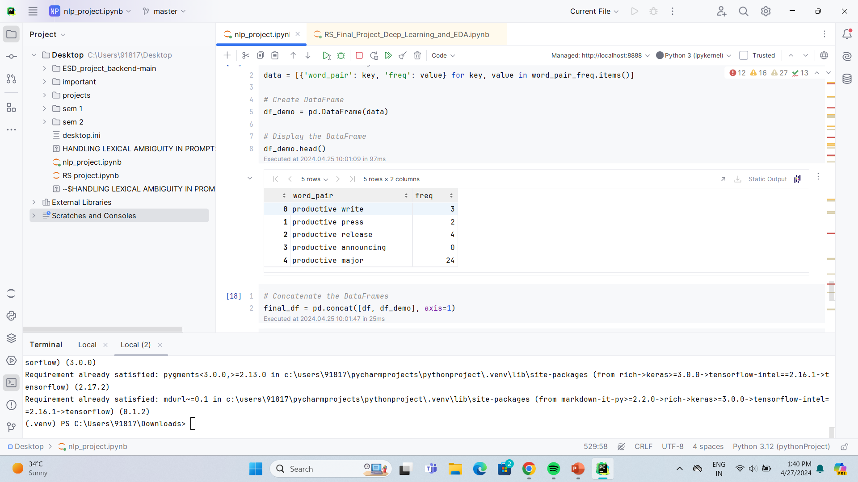
7. Frequencies of word pairs

Slide 15
Challenge faced ….
Initially when we took span width of 3 we got all counts to be zero.But as we increased our span width to 9,27,81… we got most of the count values to be zero.At span width of 2187 we got very less non zero values.so we picked 2187.Span width 3 and later values didn’t work because we took a subset of 100 examples of wikipedia corpus.

Slide 16
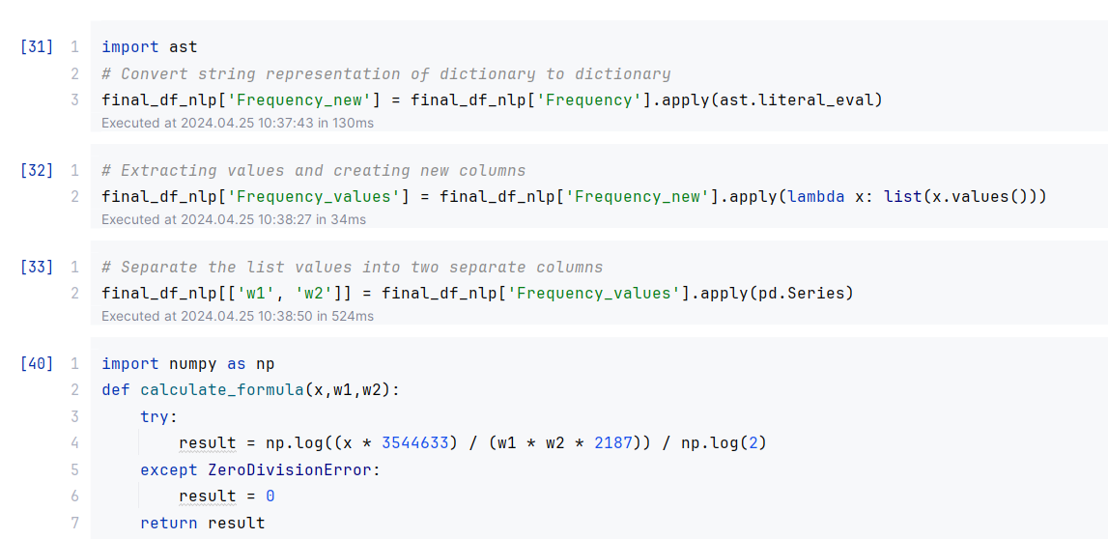
8. Finding Collocation score and getting the senses

Slide 17
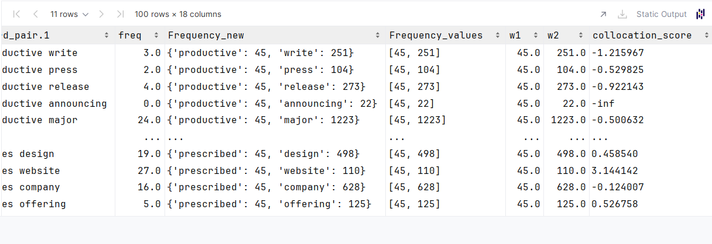

Slide 18
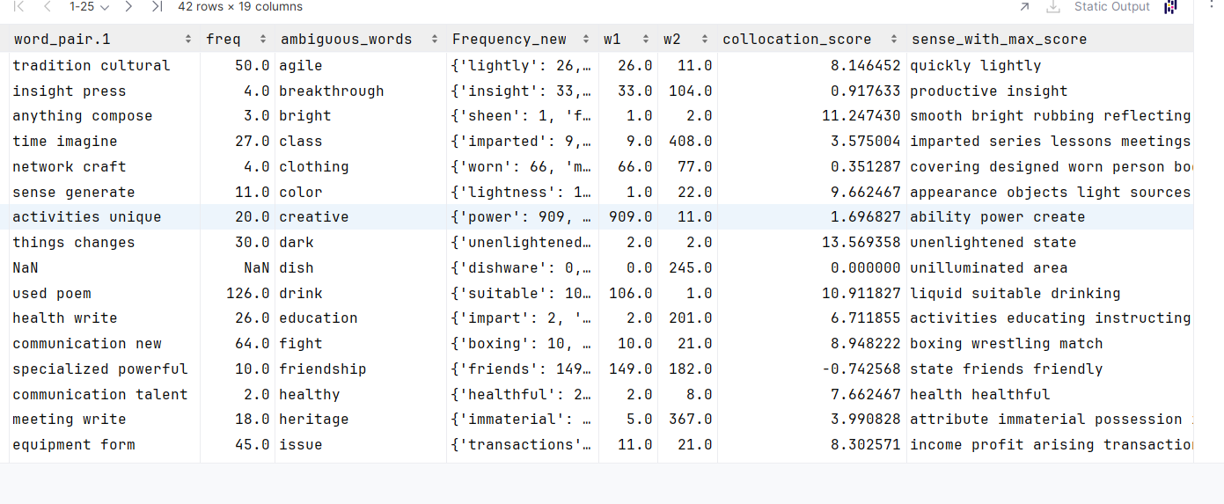
9. Senses

Slide 19
Conclusion and future scope
As a result of encountering challenges during the aforementioned steps, we were constrained to operate with smaller datasets, which unfortunately yielded suboptimal outcomes.
However, if we have access to more powerful computers, we can analyze the entire Wikipedia collection and use a larger dataset of prompts.
This advancement is expected to significantly enhance our results, offering a more comprehensive and impactful analysis.

Slide 20
Reference
[1] https://www.sciencedirect.com/science/article/pii/S1319157821002007

Slide 21
THANK YOU

